Slide 1

CST1302 Foundation of Web Programming
A. A. Datti

Slide 2
Course Outline
Introduction to WWW
Structuring and Formatting with HTML
Styling with CSS

Slide 3
Learning Outcomes
In this chapter, you will learn about:
Overview of the Internet
Introduction to the World Wide Web
Writing a basic HTML web page

Slide 4

The Internet vs. The Web
The Internet is a worldwide network of computers all attached in a global networking scheme.

Slide 5

The Internet vs. The Web
The World Wide Web is a collection of electronic documents (containing text, graphics, and even multimedia contents) that are linked to one another via hyperlinks.

Slide 6
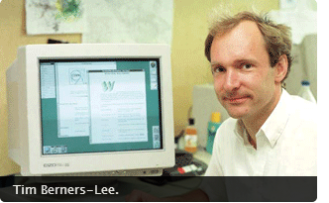
History of the Web
Tim Berners-Lee invented the World Wide Web in 1989, about 20 years after the first connection was established over what is today known as the Internet
At that time, Tim was a software engineer at CERN, the large particle physics laboratory near Geneva, Switzerland. He is currently a professor at the Department of Computer Science University of Oxford AND MIT.

Slide 7
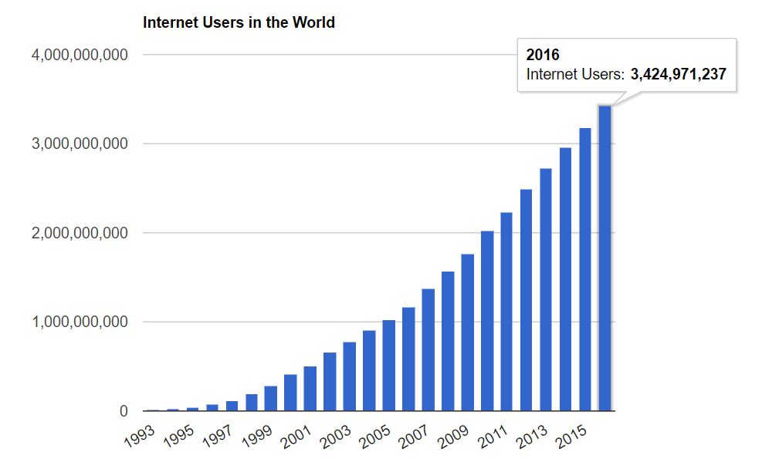
Growth of Internet (www.internetlivestats.com)

Slide 8
Fundamental technologies of WWW
WEB CLIENT: Requests and receives WEB PAGES from server.
WEB SERVER: Receives and responds to request for WEB PAGES by clients
HTML: HyperText Markup Language. The publishing format for the Web, including the ability to format documents and link to other documents and resources.
HTTP: Hypertext Transfer Protocol. Allows for the retrieval of linked resources from across the Web
URL: Uniform Resource Locator. A kind of “address” that is unique to each resource on the Web.

Slide 9
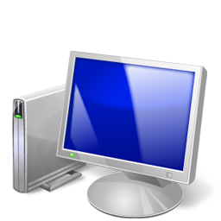
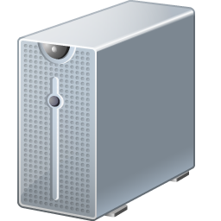

How the Web Works?
WWW use classical client / server architecture
HTTP is text-based request-response protocol
HTTP
Page request
HTTP
Server response
Client running a Web Browser
Server running Web Server Software (IIS, Apache, etc.)

Slide 10
Web Client
Connected to the Internet when needed
Usually runs web browser (client) software such as Google Chrome, Opera or Firefox
Uses HTTP (Hypertext Transfer Protocol)
Requests web pages from server
Receives web pages and files from server

Slide 11
Web Server
Continually connected to the Internet
Runs web server software (such as Apache or Internet Information Server)
Uses HTTP (Hypertext Transfer Protocol)
Receives request for the web page
Responds to request and transmits status code, web page, and associated files

Slide 12
HTTP Hypertext Transfer Protocol
A set of rules for exchanging files such as text, graphic images, sound, video, and other multimedia files on the Web.
Web browsers send HTTP requests for web pages and their associated files.
Web servers send HTTP responses back to the web browsers.
HTTP Request
HTTP Response

Slide 13
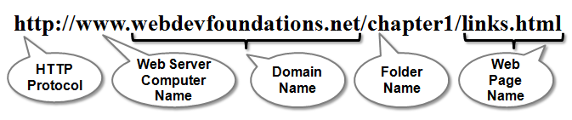
URL Uniform Resource Locator
URL
Represents the address of a resource on the Internet.

Slide 14
What is a Web Page?
Web pages are text files containing HTML
HTML – Hyper Text Markup Language
A notation for describing
document structure (semantic markup)
formatting (presentation markup)
Looks like:
A Microsoft Word document
The markup tags provide information about the page content structure

Slide 15
Creating HTML Pages
An HTML file must have an .htm or .html file extension
HTML files can be created with text editors:
NotePad, NotePad ++, PSPad
Or more advanced HTML editors:
Macromedia Dreamweaver
Netscape Composer
Microsoft Visual Studio

Slide 16
Creating HTML using notepad
Step 1: Go to my computer
Step 2: double click c: / drive
Step 3: create a new folder and name it web programming
Step 4: Open notepad in accessories
Step 5: Type your html code into your notepad
Step 6: In the notepad go to file, click save as.
Step 7: In the save as dialog box, move to the location of web programming folder you initially created.
Step 8: type the name of your document in the file name box with the extension .html. Click save

Slide 17
Running html in the browser
Step 1: go to my computer
Step 2: double click c:/ drive
Step 3: go to web programming folder
Step 4: find the document and double click it.
the html document will open with your default browser.

Slide 18
Creating a simple web page
To start - Create a Folder:
You’ll find it helpful to create folders to organize your files as you develop the web pages in this book and create your own websites.
To create a new folder with Windows:
Launch Windows Explorer (either press the Windows key or select Start > All Programs > Accessories > Windows Explorer), and navigate to the location where you would like to create the new folder, such as My Documents or your C: drive.
Right Click > New > Folder.
To rename the New Folder, right-click on it, select Rename from the context menu, type in the new name, e.g mynameWebpages and press the Enter key.

Slide 19
Creating a simple web page
Launch Notepad or another text editor and type in the following code.
<!DOCTYPE html>
<head>
<title>My First Web Page</title>
</head>
<body>
<h1>Welcome!</h1>
<p>Hi, I am __________, with Registration number CST/16/COM/0000. </p> <p>I think I’ll enjoy web programming.</p>
</body>
</html>
Save your Document as “myFirstWebPage.html”
NOTE: the quotations marks are also part of the file name

